Slide 1
CLOUDERA DATA PLATFORM
8th April 2022

Slide 2



Cloudera Team
Suresh MR
Director - Channels & Alliances
Vinay Rayker
Partner Technology Leader
Manick Mehra
Partner Solutions Engineer
© 2019 Cloudera, Inc. All rights reserved.
2

Slide 3
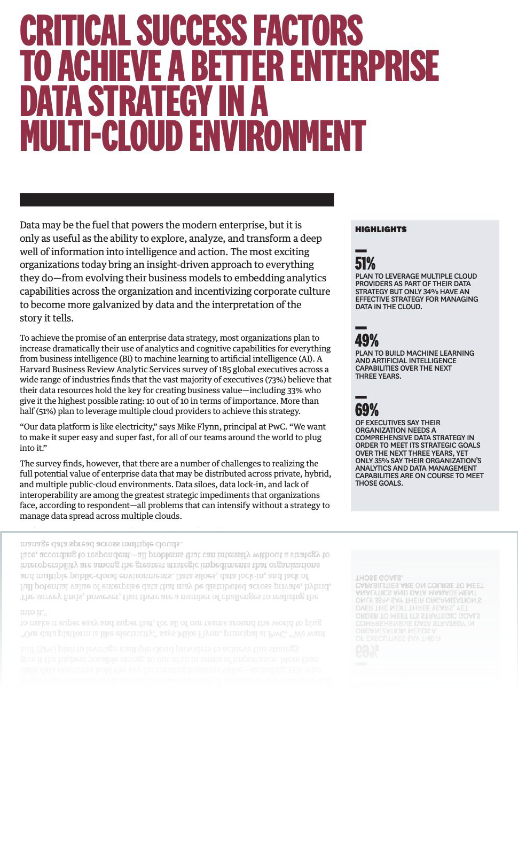


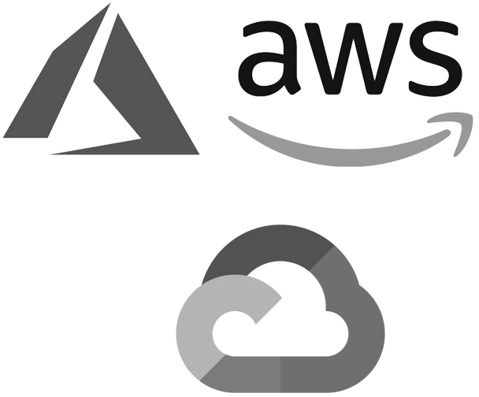


DATA MANAGEMENT IS SPREAD ALL OVER
47%
On-premises
32%
Private cloud
26%
Hybrid cloud
24%
Multi cloud
21%
Single cloud
Gartner recently warned that “Data and analytics leaders must prepare for the complexities of multi cloud and intercloud deployments to avoid potential performance issues… unplanned cost overruns and ... diﬃculties with integration efforts.”
© 2019 Cloudera, Inc. All rights reserved.
2

Slide 4

CLOUDERA’S VISION FOR HYBRID DATA CLOUD
Build once, run anywhere, on any infrastructure
Freedom to move existing and future applications, data, and users bi-directionally between the data centre and multiple public clouds without rewriting
Applications include streams, pipelines, databases, workspaces, and other data products
Data considerations include formats, schema, tags, policies, and other metadata
Users need to leverage existing skills and processes, while continuously modernising
© 2021 Cloudera, Inc. All rights reserved.
4

Slide 5



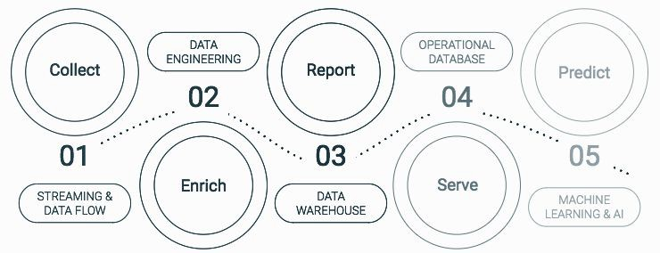


THE HYBRID DATA CLOUD COMPANY
Any Cloud
Data Lifecycle
Secure & Governed
Open
© 2021 Cloudera, Inc. All rights reserved.
4

Slide 6
HOW DO CUSTOMERS USE CLOUDERA?
Every business use case is a data lifecycle use case
BANKING
TECHNOLOGY
TELCO
LIFE SCIENCES
MANUFACTURING
Fraud detection
Anti-money laundering
Spend analytics
Customer analytics
Threat detection
Predictive support
Churn analysis
Customer care
Network optimization
Patient care (IoT)
Genomics research
Regulatory compliance
Predictive maintenance (IoT)
Supply chain optimization
Remote monitoring
USE CASES
Barclays
Citi
Santander UK
Cisco
Intel
Reef Technology
Globe Telecom
Deutsche Telecom
Robi Axiata
GlaxoSmithKline
Clearsense
Cerner
Navistar
Micron
Sikorsky
KEY CUSTOMERS
© 2021 Cloudera, Inc. All rights reserved.
4

Slide 7
EMERGING CUSTOMER PATTERNS FOR HYBRID DATA CLOUD
DATA AGILITY
Replicate production data sets to primary cloud to improve agility & innovation
APPLICATION MIGRATION
Migrate whole apps or clusters to primary cloud without rewrite (and back)
APPLICATION PORTABILITY
Move data and apps between clouds or back on prem as business conditions change
DYNAMIC MOTION
Federate data and apps across environments based on ﬁnancial and regulatory policies
© 2021 Cloudera, Inc. All rights reserved.
7

Slide 8
What is CDP?

Slide 9
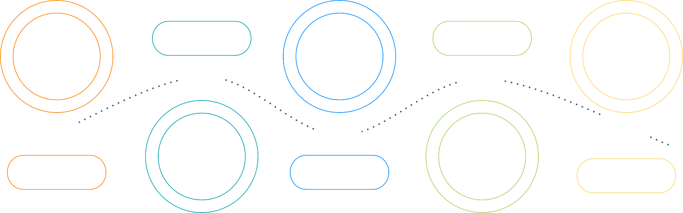
CLOUDERA - THE HYBRID DATA CLOUD COMPANY
Manage and secure the data lifecycle in any cloud or datacenter
DATA ENGINEERING
OPERATIONAL DATABASE
Collect
Report
Predict
02
04
01
STREAMING & DATA FLOW
03
DATA WAREHOUSE
05
MACHINE LEARNING & AI
Enrich
Serve
SECURITY | GOVERNANCE | INTELLIGENCE | METADATA | CATALOG
© 2019 Cloudera, Inc. All rights reserved.

Slide 10





POINT SOLUTIONS HAVE AN INTEGRATION TAX
Result: Higher Net OpEx, TCO ... Security and governance (GDPR, etc.) is an afterthought
DATA ENGINEERING
OPERATIONAL DATABASE
02
04
01
STREAMING & DATA FLOW
03
DATA WAREHOUSE
05
MACHINE LEARNING & AI
SECURITY | GOVERNANCE | LINEAGE | MANAGEMENT | AUTOMATION
© 2019 Cloudera, Inc. All rights reserved.

Slide 11

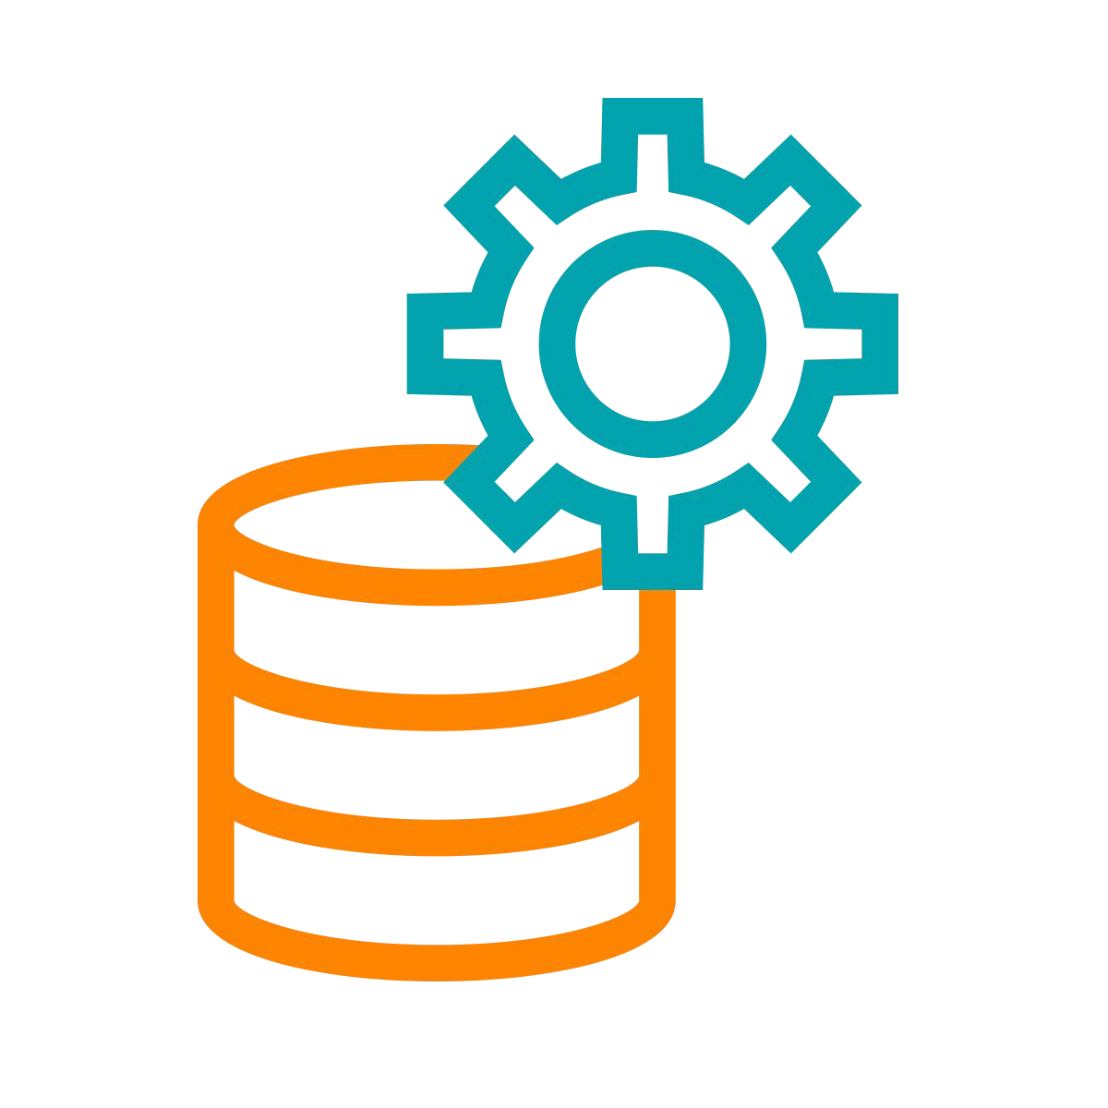

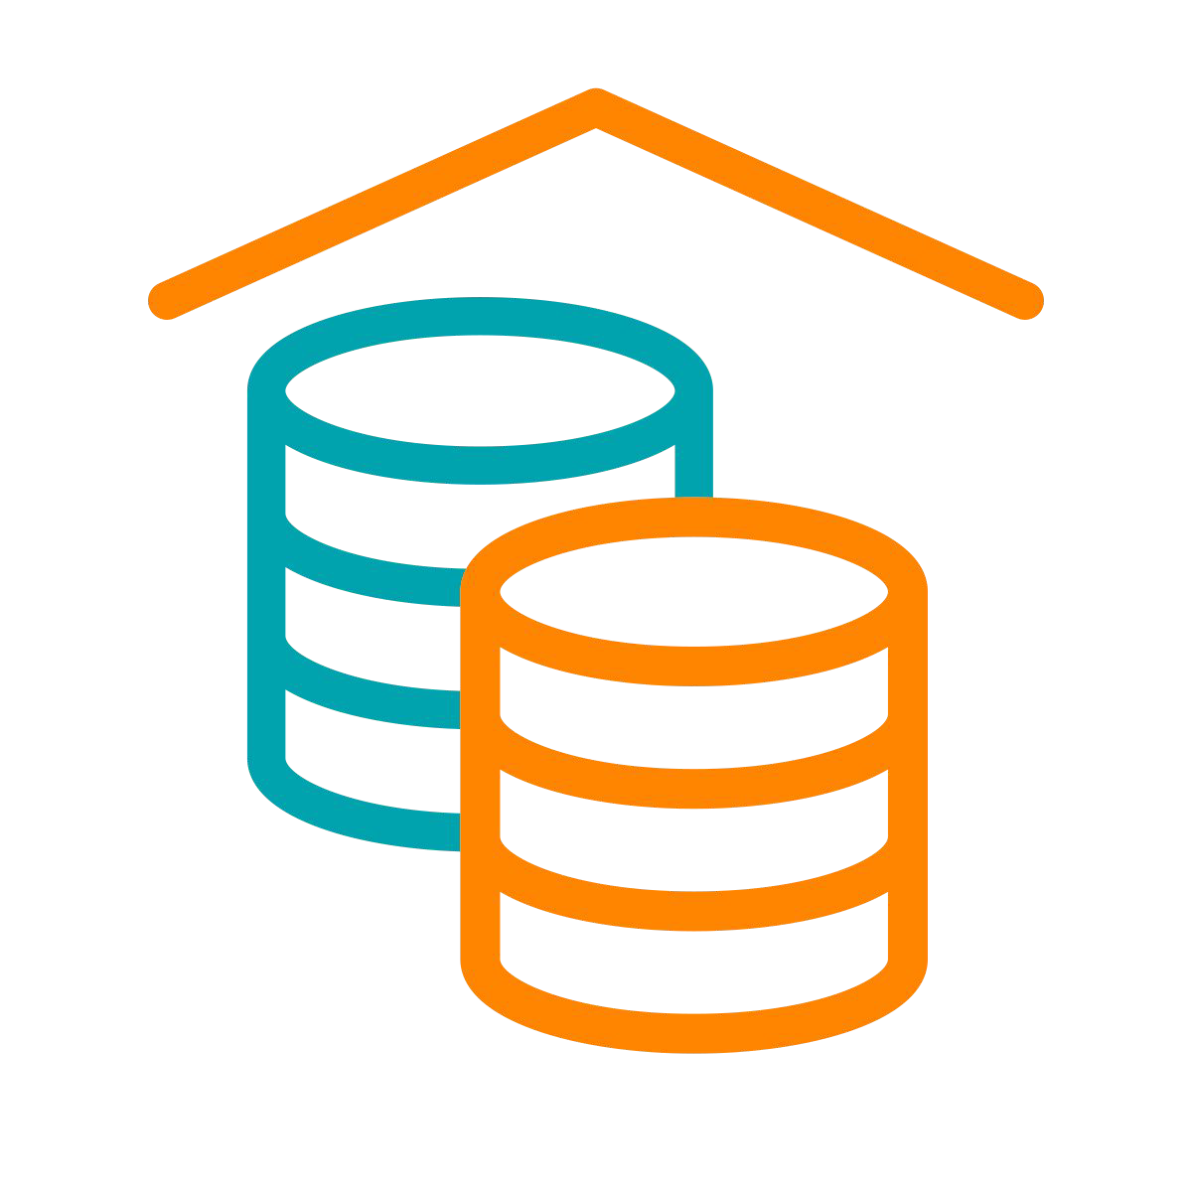
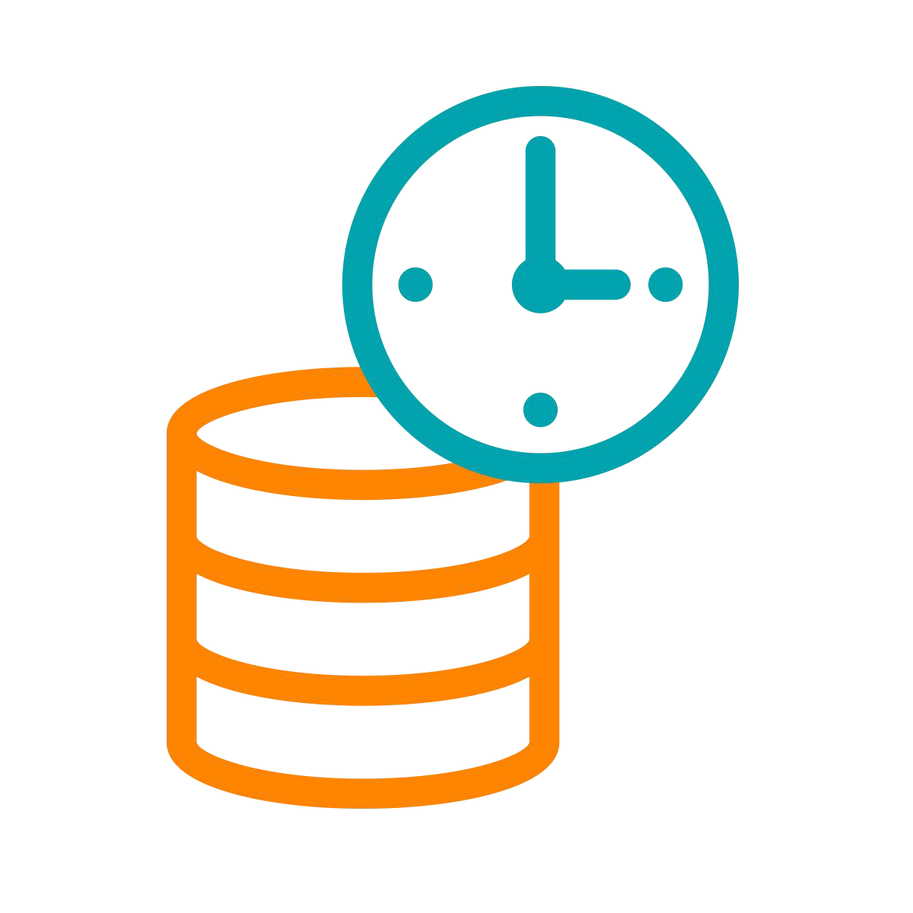


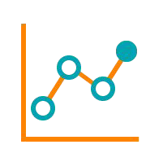









A HYBRID / MULTI-CLOUD DATA PLATFORM AND
AN INTEGRATED SUITE OF SECURE ANALYTIC APPS
Real-time Batch Structured Unstructured
Data Sources
Analysts Engineers Scientists Developers
Data Users
Data Collection
Data Engineering
Virtual Data Lake
Data Warehouse
Operational Database
Streaming Analytics
Machine Learning
Data Visualization
Cloudera Data Platform
Data Lifecycle integration for better user productivity and faster time to value
Hybrid & Multi-Cloud to leverage existing investments and reduce risk
Secure & Governed to simplify data protection, sharing and compliance
Open & Extensible to support more use cases faster and at lower cost
© 2021 Cloudera, Inc. All rights reserved.

Slide 12


ONE PLATFORM – TWO FORM FACTORS
CDP Public Cloud
(platform-as-a-service)
CDP Private Cloud
(platform as installable software)
Control Plane
Bare Metal
Container Cloud
AWS
Azure
GCP
Traditional Workloads
Self-Serve Experiences
Traditional Workloads
Self-Serve Experiences
Data Hub
DW, ML, DE, …
Data Hub
DW, ML, DE, …
Servers
Containers
Servers
Containers
Cloudera Runtime
© 2021 Cloudera, Inc. All rights reserved.

Slide 13
CLOUDERA DATA SERVICES
Data services are next generation, practitioner-focused analytic capabilities delivered as modular cloud services. Data services can be standalone offerings or combined into integrated patterns that deliver a seamless data lifecycle experience.
Cloudera Data Services share a common management, security, and governance framework and provide a consistent experience in any cloud.

Slide 14




CLOUDERA DATA SERVICES
Build and run your data apps once and run them anywhere on a single data platform
PURPOSE BUILT
MODULAR ANALYTICS
CLOUD SERVICES
SECURE & GOVERNED
Designed for practitioners
All-inclusive toolkits
Platform integration
DataFlow
Data Engineering
Data Warehouse
Operational Database
Machine Learning
Private & public clouds
Consistent user experience
Common admin controls
Built on SDX framework
Simpler compliance
End-to-end visibility
© 2019 Cloudera, Inc. All rights reserved.

Slide 15




CLOUDERA BUSINESS VALUE
Empowering people to transform complex data into clear and actionable insights
FASTER TIME TO VALUE
BETTER TCO/ROI
ONE PLATFORM UNLIMITED UTILITY
Increased user productivity
Higher ROI versus competition
One Data Cloud for Business & IT
© 2019 Cloudera, Inc. All rights reserved.

Slide 16






CLOUDERA POWERING DATA-DRIVEN CUSTOMERS
At-scale migration from on-premises to public cloud for increased ﬂexibility and scale
Enabling new growth opportunities via CDP Public Cloud and streaming analytics
Increasing ROI via a hybrid cloud for massively scalable, real-time data ingestion
© 2019 Cloudera, Inc. All rights reserved.

Slide 17
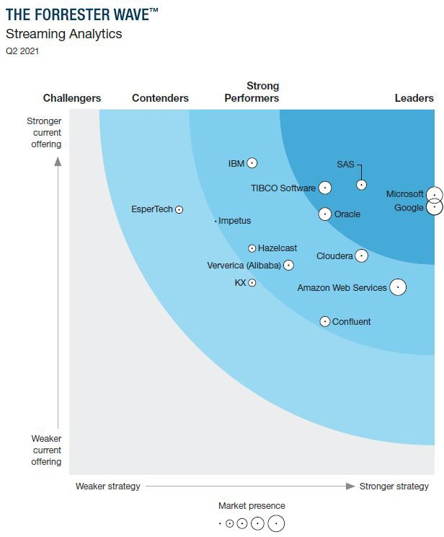
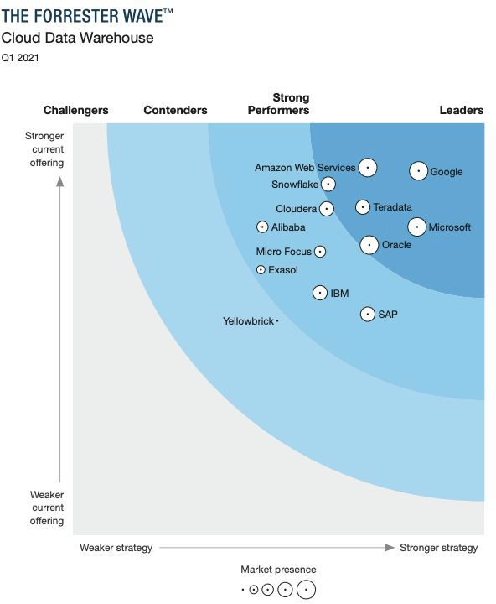
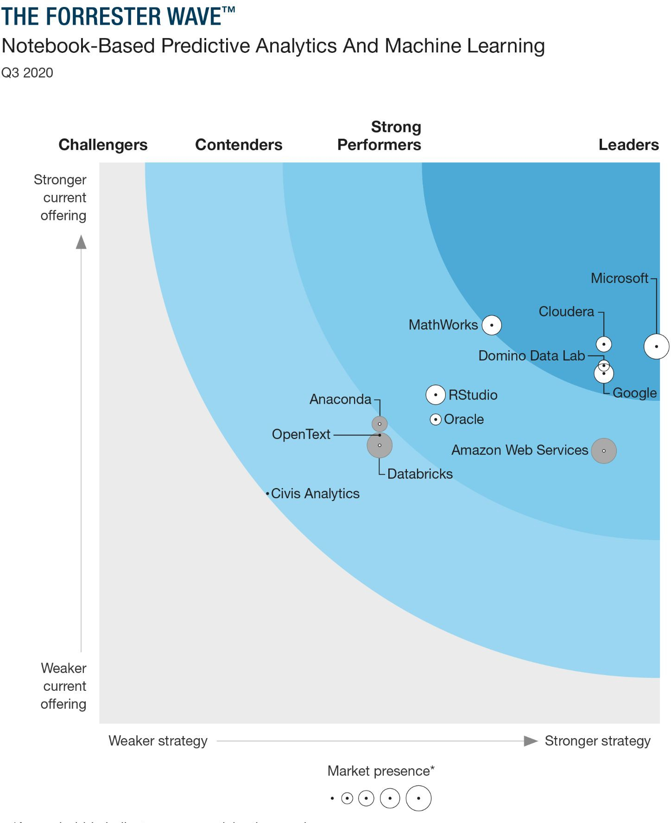
CLOUDERA RECOGNIZED IN FORRESTER WAVES
Streaming Analytics Data Warehouse
Machine Learning
© 2019 Cloudera, Inc. All rights reserved.

Slide 18


COMPETITIVE LANDSCAPE
Cloudera stands out as a hybrid and multi cloud platform for data management and analytics with enterprise security and governance powered by open-source innovation
CLOUDERA
DW,ML,DE,OD,DF
CLOUD ONLY
Databricks, Snowﬂake, Conﬂuent
PUBLIC CLOUD
EMR, Dataproc, HDI, Redshift, Sagemaker
Hybrid & multi-cloud
Common security & governance
Integrated data lifecycle
Open & extensible
© 2019 Cloudera, Inc. All rights reserved.

Slide 19



CLOUD PROVIDERS HAVE A DIFFERENT VISION FOR HYBRID
HYBRID
Rewrite your apps to my stack starting from within your data center
But the on prem stack is limited in scope
And perpetually lags the public cloud
And you have to ﬁnish the migration to get full value
And now your rewritten app is only compatible with one public cloud
© 2019 Cloudera, Inc. All rights reserved.

Slide 20
What's in it for you?

Slide 21
MARKET OPPORTUNITY
$52.8B
Outlook
Public cloud share will increase from 25% to 50% of market for Big Data & Analytics
Cloud deployments expected to grow 35% CAGR
On-premises deployments expected to grow 9% CAGR
IoT-related data CAGR of 29% through 2025 not represented in market sizing
$4.9B
Streaming Analytics
$17.4B
AI / ML / Data Science
$26.6B
$1.8B
Streaming Analytics
$12.0B
Non-Relational DataStore
$7.1B
AI / ML / Data Science
$4.9B
Non-Relational DataStore
$18.5B
Analytic Data Platforms
$12.8B
Analytic Data Platforms
2019
2023
© 2019 Cloudera, Inc. All rights reserved.

Slide 22
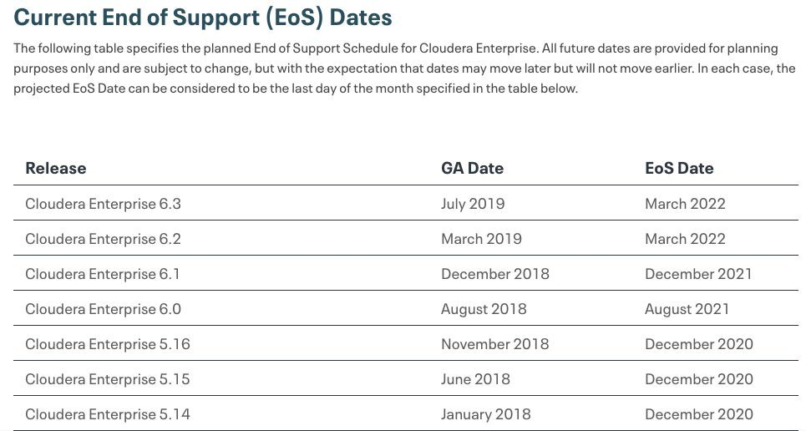
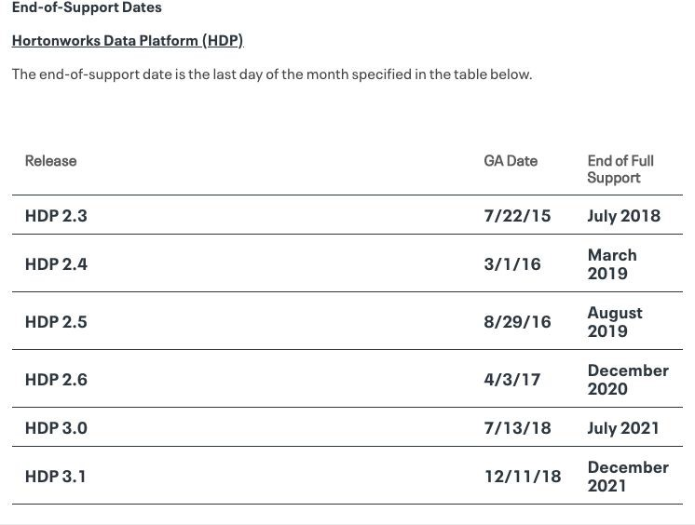
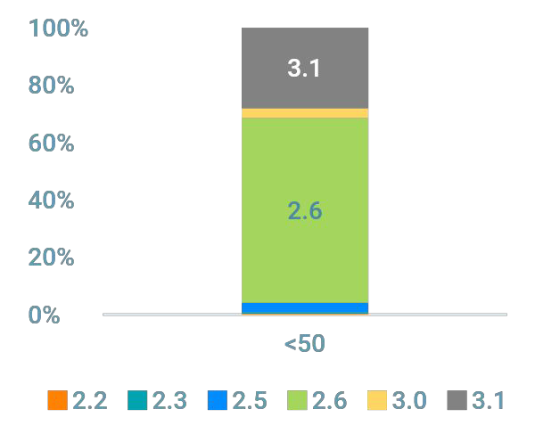
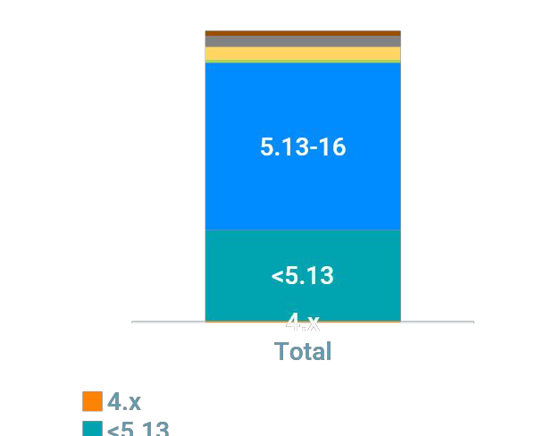
~70% OF CUSTOMERS ON HDP2 AND CDH5
Version Distribution of Clusters
HDP
CDH
© 2019 Cloudera, Inc. All rights reserved.

Slide 23




Opportunities ahead of us
Cloudera Data Platform (CDP)
CDP Upgrade from CDH & HDP
New Workloads for existing customers
Point workloads for new customers
Data Life Cycle Projects for new customers
3-way partnership – You, Cloudera and Redhat – winning Private Data Cloud Business
3-way partnership – You, Cloudera and Cloud Infrastructure Vendors (AWS, Azure & GCP) – Winning Public Data Cloud business
© 2019 Cloudera, Inc. All rights reserved.

Slide 24
THANK YOU
© 2019 Cloudera, Inc. All rights reserved.

